Slide 1
Object-Oriented Programming (OOP)
Week – 06
Mar 09-13, 2020
Instructor: Basit Ali
Email: basit.jasani@nu.edu.pk
Object-Oriented Programming (OOP)

Slide 2
Object Relationship
is-a relationship
has-a relationship

Slide 3
has-a Relationship
In a has-a relationship, an object contains one or more objects of other classes as members
A car has a steering
An office has a department

Slide 4
has-a Relationship
class Office
{
Department d;
// any other members
};

Slide 5
is-a Relationship
Sometimes, one class is an extension of another class
A car is a vehicle Cricket is a sport

Slide 6
is-a Relationship
The extended (or child) class contains all the features of its base (or parent) class, and may additionally have some unique features of its own
The key idea behind inheritance

Slide 7
Inheritance
Capability of a class to derive properties and characteristics from another class.
One of the most important feature of Object Oriented Programming

Slide 8
Concepts
Sub Class: The class that inherits properties from another class is called Sub class or Derived Class or Child Class.
Super Class: The class whose properties are inherited by sub class is called Base Class or Super class or Parent Class.

Slide 9
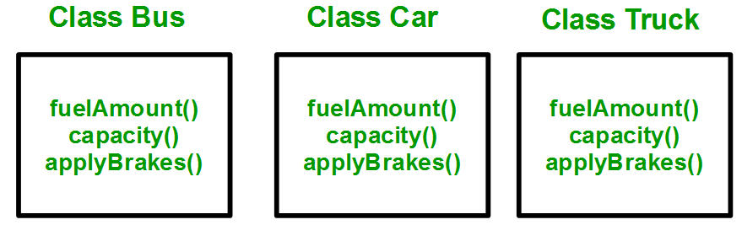
Why and when to use inheritance?
Consider a group of vehicles. You need to create classes for Bus, Car and Truck. The methods fuelAmount(), capacity(), applyBrakes() will be same for all of the three classes.

Slide 10
Why and when to use inheritance?
You can clearly see that above process results in duplication of same code 3 times. This increases the chances of error and data redundancy. To avoid this type of situation, inheritance is used.

Slide 11
Why and when to use inheritance?
If we create a class Vehicle and write these three functions in it and inherit the rest of the classes from the vehicle class, then we can simply avoid the duplication of data and increase re-usability.

Slide 12
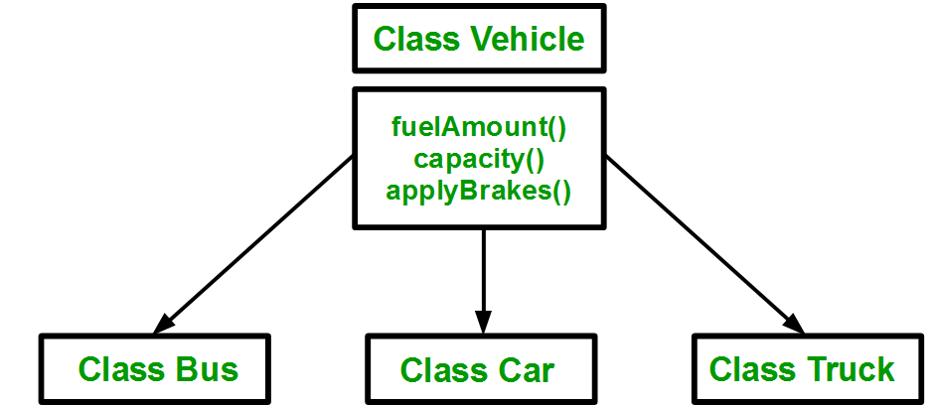
Why and when to use inheritance?

Slide 13
Implementing inheritance in C++
Syntax:
class subclass_name : access_mode base_class_name
{
//body of subclass
};

Slide 14
Modes of Inheritance
Public mode: If we derive a sub class from a public base class. Then the public member of the base class will become public in the derived class and protected members of the base class will become protected in derived class.
Protected mode: If we derive a sub class from a Protected base class. Then both public member and protected members of the base class will become protected in derived class.
Private mode: If we derive a sub class from a Private base class. Then both public member and protected members of the base class will become Private in derived class.

Slide 15
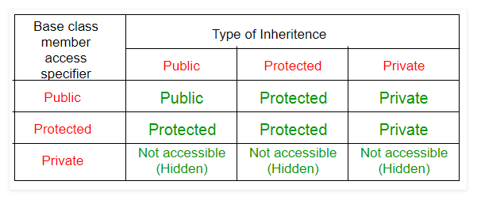
Modes of Inheritance

Slide 16
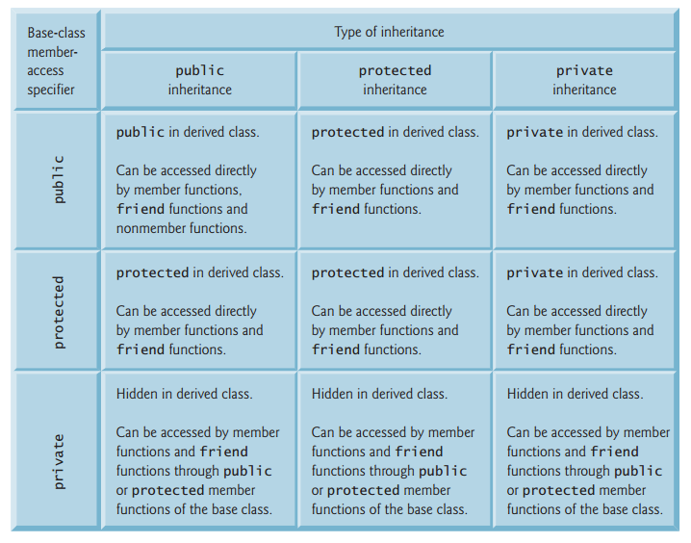

Slide 17
Types of Inheritance in C++
Single Inheritance
Multiple Inheritance
Multilevel Inheritance
Hierarchical Inheritance
Hybrid (Virtual) Inheritance

Slide 18
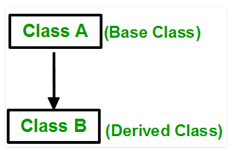
Single Inheritance
In single inheritance, a class is allowed to inherit from only one class. i.e. one sub class is inherited by one base class only.

Slide 19
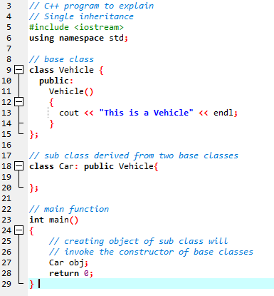
Single Inheritance (Continue..)
Syntax:
class subclass_name : access_mode base_class
{
//body of subclass
};

Slide 20
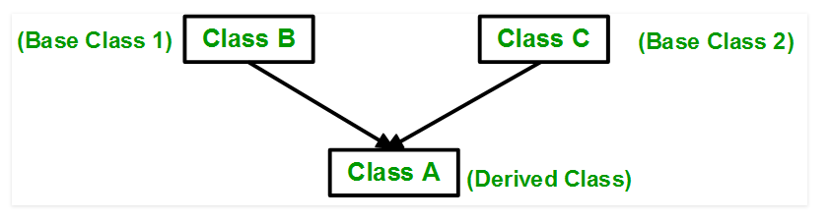
Multiple Inheritance
Multiple Inheritance is a feature of C++ where a class can inherit from more than one classes. i.e one sub class is inherited from more than one base classes.

Slide 21
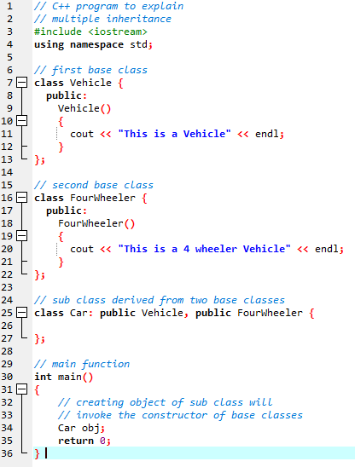
Multiple Inheritance (Continue..)
Syntax:
class subclass_name : access_mode base_class1,
access_mode base_class2, ....
{
//body of subclass
};

Slide 22
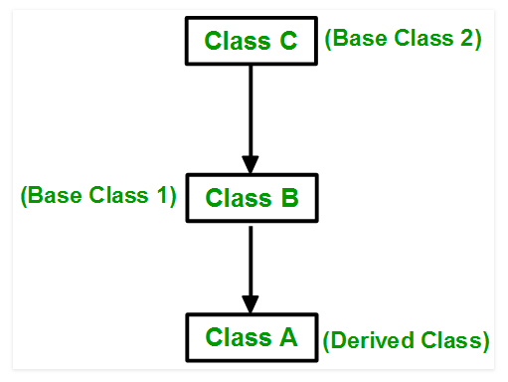
Multilevel Inheritance
In this type of inheritance, a derived class is created from another derived class.

Slide 23
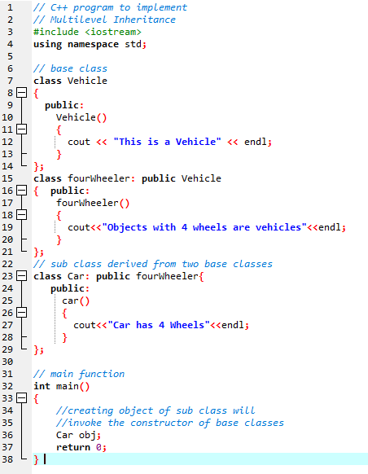
Multilevel Inheritance (Continue..)

Slide 24
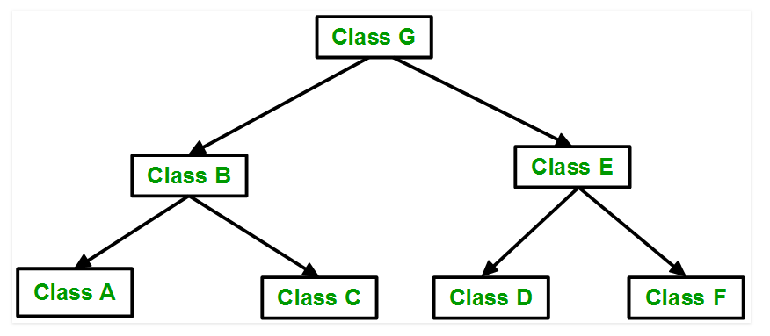
Hierarchical Inheritance
In this type of inheritance, more than one sub class is inherited from a single base class. i.e. more than one derived class is created from a single base class.

Slide 25
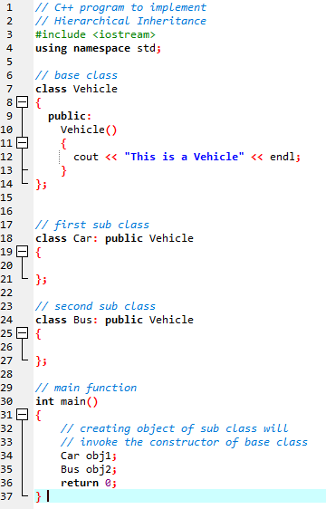
Hierarchical Inheritance (Continue..)

Slide 26
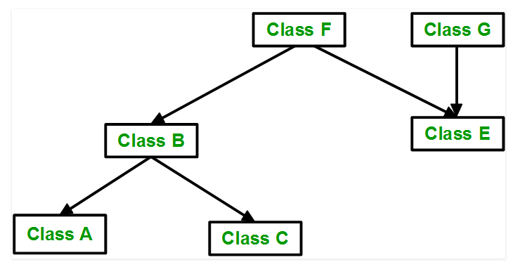
Hybrid (Virtual) Inheritance
Hybrid Inheritance is implemented by combining more than one type of inheritance. For example: Combining Hierarchical inheritance and Multiple Inheritance.

Slide 27
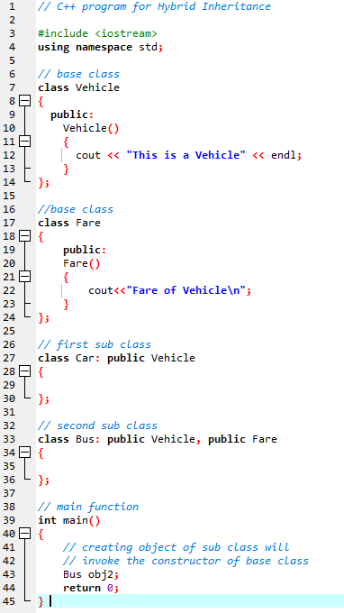
Hybrid Inheritance (Continue..)

Slide 28
Order of constructor and Destructor call
Whenever we create an object of a class, the default constructor of that class is invoked automatically to initialize the members of the class. If we inherit a class from another class and create an object of the derived class, it is clear that the default constructor of the derived class will be invoked but before that the default constructor of all of the base classes will be invoke, i.e the order of invokation is that the base class’s default constructor will be invoked first and then the derived class’s default constructor will be invoked.

Slide 29
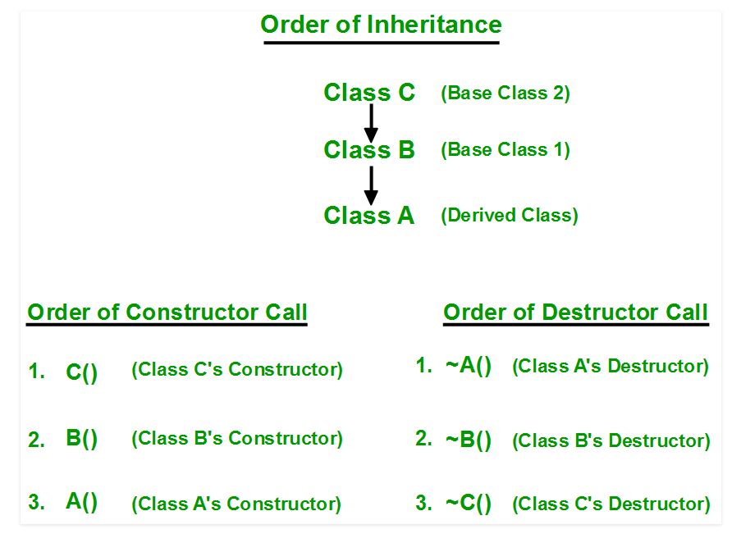
Order of constructor and Destructor call

Slide 30
Concept: Calling parameterized constructor of base class in derived class constructor!
To call the parameterized constructor of base class when derived class’s parameterized constructor is called, you have to explicitly specify the base class’s parameterized constructor in derived class

Slide 31
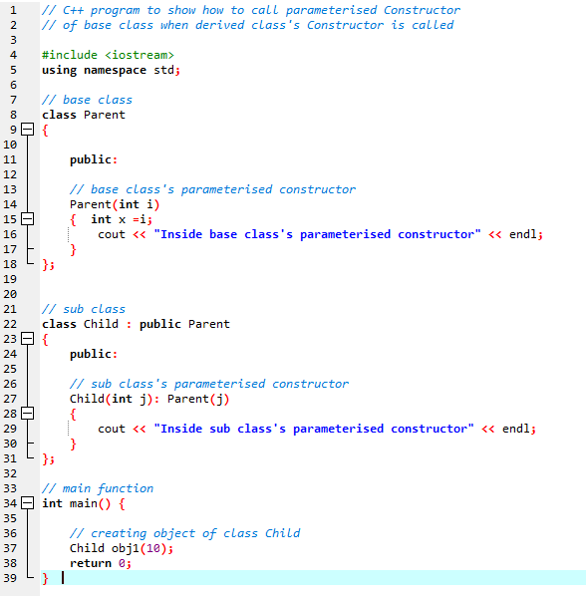
Concept: Calling parameterized constructor of base class in derived class constructor!

Slide 32
Important Points
Whenever the derived class’s default constructor is called, the base class’s default constructor is called automatically.
To call the parameterized constructor of base class inside the parameterized constructor of sub class, we have to mention it explicitly.
The parameterized constructor of base class cannot be called in default constructor of sub class, it should be called in the parameterized constructor of sub class.

